Slide 1

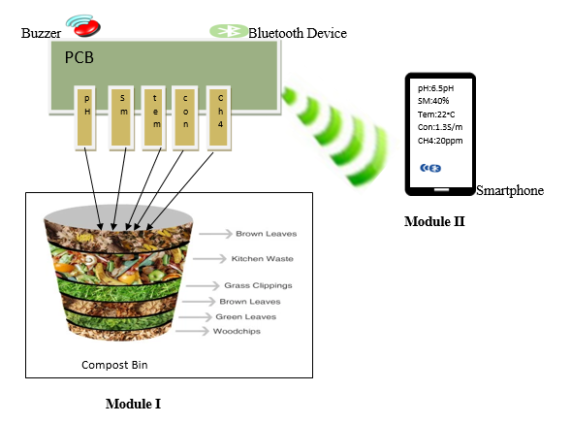
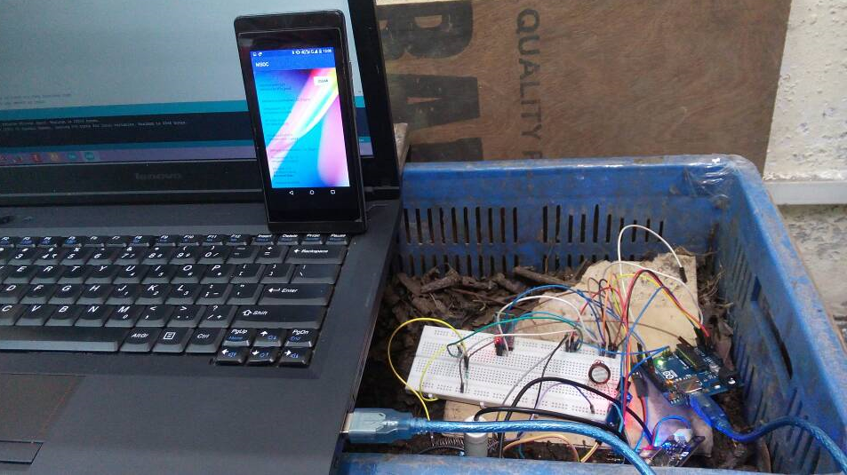
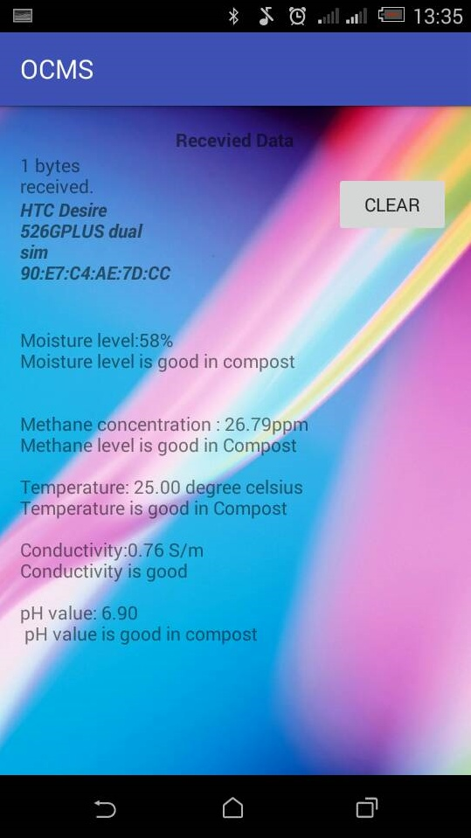
In this system the transmission media used is Bluetooth to communicate between the sensor devices in the compost to the app in the smart phone from the Module I to Module II.
Group Members
Chandra Kumari Subba
Tulsi Maya Pradhan
Mrs. Lekikha Chettri
SMART PHONE APP BASED
ORGANIC COMPOST MONITORING SYSTEM
DEPARTMENT OF COMPUTER APPLICATIONS
SIKKIM UNIVERSITY
Affiliation
Logo
ABSTRACT
Urban farming and roof top farming is attracting interest of many people but unavailability of compost in these areas can hinder people’s interest. Therefore, by preparing organic compost from kitchen waste will be able to fulfill their needs and also they don’t have to go rural areas to purchase compost which may get expensive. But collecting and dumping waste material in a bin is not sufficient for the compost formation as sometimes due to various factors the waste may decay instead of decomposing. With this motivation, our project entitled Design and Development of Organic Compost Monitoring System is designed and developed to monitor and measure a set of performance parameters (values) of organic compost. The monitoring system comprises of sensor microcontroller (Arduino), Bluetooth device, Buzzer and the OCMS App. The sensors pH sensor, temperature sensor, methane sensor (CH4) sensor, soil moisture sensor and conductivity sensor will sense values from the organic compost and the values sensed will be send to the designed app installed in the smart phone for monitoring purpose and in case value below or above the threshold then the buzzer will buzz . This communication between the app and the integrated device happens with a Bluetooth device. The OCMS app will not only display the result of the measured parameters but it will also provide a standard and solution table for the sensor and will also guide on preparing of an organic compost from the information block i.e., given in the OCMS app.
METHODLOGY
Module I-It consist of a Compost bin, Bluetooth device and a Buzzer. The compost bin is use to decompose organic material that will be used as a fertilizer for urban vegetation. Bluetooth device (HC-05) is used to transmit data sensed from the bin by various sensors from module I to module II, and a Buzzer (Be Star BMS16 33.13) is used as a signaling device that gets its instruction from module I and it only buzz if the sensed values of compost is above or below the standard value.
Module II - It is a Smart Phone based app named as “OCMS” which is capable of displaying the values detected by the sensors that are placed in the organic material. In this system the transmission media used is Bluetooth.
RESULTS
REFERENCES
[1]. Nikki Phipps, “Composting basic: how does Composting work”, vol.316, Dec 24, 2015.
[2]. “Ardunio-Introduction”.aurdino.cc.

Slide 2

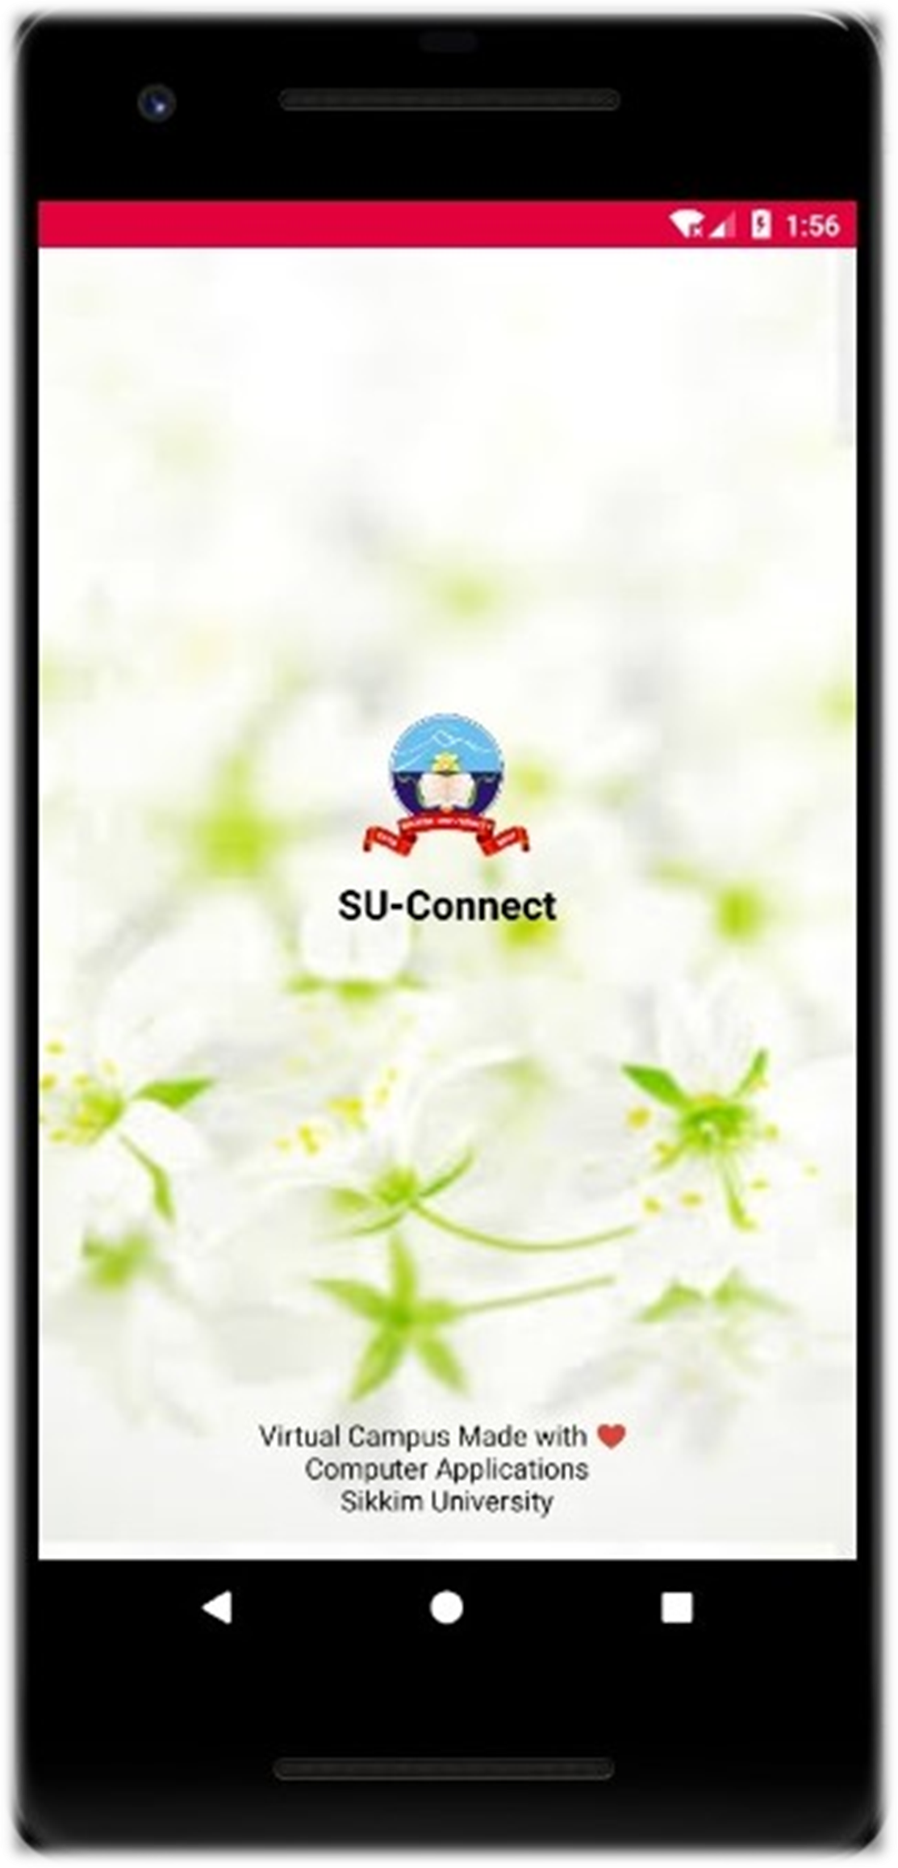
Department of Computer Application
Sikkim University
Pritam Shah &
Robin Gurung
SU-Connect: Virtual Campus for Sikkim University that helps to connect almost everyone. Flooded with Features.
Sikkim University
SU-Connect
Android Application
Qualities
This app has a strong user focus. With efficient and simple UI.

